Slide 1


What Is
Your Life? #1
James 4:13-17

Slide 2

Thinking about Death
Ecclesiastes 7:2-4

Slide 3

We are Immortal
Genesis 1:26-27; 2:7 (Eccl. 12:7)
Image of God
Life is more than physical
Mortal lives affect immortality, Galatians 6:7-9

Slide 4
Psalm 90:10-12; 89:47-48; 78:39
Mortal | Immortal
Temporary | Forever
Uncertain | Certain
Changes | Unchanging
Accountable | Outcome
2 Corinthians 4:16–5:1

Slide 5
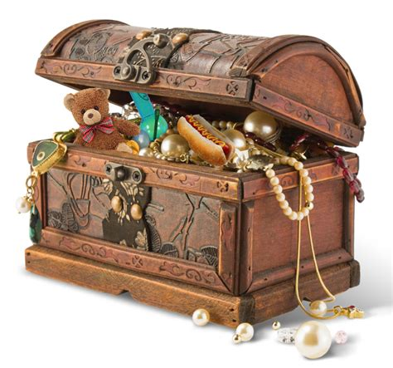
What Defines Us Shapes Our Eternity
Matthew 6:19-21; 16:26
James 4:13-17
What we value
Where we store it
How we view life
How we view death

Slide 6
“What is Your Life?”
James 4:14
Gift from God, Isaiah 42:5
Vapor, Psalm 39:4-6
  “Know my end”
  “Frail”

Slide 7
“What is Your Life?”
James 4:14
Show what we think about
life by how we live it
  Money and the moment,
  Luke 12:13-21
    VANITY (Eccl. 1:2, 8)

Slide 8
“What is Your Life?”
James 4:14
Show what we think about
life by how we live it
  Heaven and eternity,
  Hebrews 11:13-16; 12:1-2
    FAITH (Heb. 11:1)

Slide 9
No One Can Serve Two Masters
Matthew 6:24
God
Riches
Hate
Loyal
Love
Despise
Cannot Serve God and Mammon

