Slide 1
What Is Your Life? #2
Review Part 1
James 4:13-17

Slide 2
Thinking about Death
Review Part 1
Ecclesiastes 7:2-4

Slide 3
We are Immortal
Review Part 1
Genesis 1:26-27; 2:7 (Eccl. 12:7)
Image of God
Life is more than physical
Mortal lives affect immortality, Galatians 6:7-9

Slide 4
Psalm 90:10-12; 89:47-48; 78:39
Review Part 1
Mortal | Immortal
Temporary | Forever
Uncertain | Certain
Changes | Unchanging
Accountable | Outcome
2 Corinthians 4:16–5:1

Slide 5
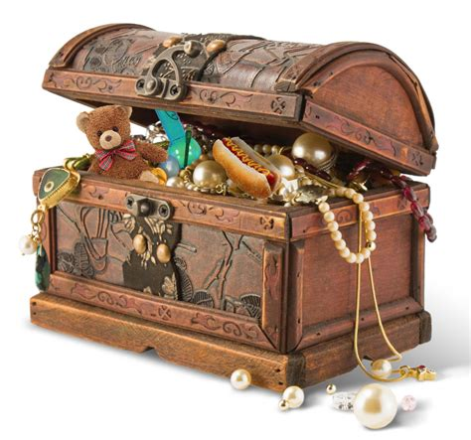
What Defines Us Shapes Our Eternity
Matthew 6:19-21; 16:26
James 4:13-17
Review Part 1
What we value
Where we store it
How we view life
How we view death

Slide 6
“What is Your Life?”
Review Part 1
James 4:14
Gift from God, Isaiah 42:5
Vapor, Psalm 39:4-6
“Know my end”
“Frail”

Slide 7
“What is Your Life?”
Review Part 1
James 4:14
Show what we think about life by how we live it
Money and the moment, Luke 12:13-21
VANITY (Eccl. 1:2, 8)

Slide 8
“What is Your Life?”
Review Part 1
James 4:14
Show what we think about life by how we live it
Heaven and eternity, Hebrews 11:13-16; 12:1-2
FAITH (Heb. 11:1)

Slide 9
No One Can Serve Two Masters
Matthew 6:24
Failure!
God
Riches
Hate
Loyal
Love
Despise
Cannot Serve God and Mammon
Review Part 1

Slide 10
What are Your Plans for Life?
James 4:13-14
Depend on God
He knows the end from the beginning, Proverbs 27:1; Isaiah 42:9; 46:10

Slide 11
What are Your Plans for Life?
James 4:13-14
Use physical life to advance spiritual life…execute the plan, Romans 6:12-14; Philippians 1:19-24 (27)
Health, 1 Timothy 4:7-8
Wealth, 1 Timothy 6:17
Time, Ephesians 5:15-16

Slide 12
How are You Achieving Your Plans?
James 4:15-17
Seek and do Lord’s will, Matthew 7:21 (Philippians 2:12-13)
Love God, Matthew 22:37-38
Love your neighbor, Matthew 22:39-40
The opposite brings heartache and destruction, James 4:1-3

Slide 13
How are You Achieving Your Plans?
James 4:15-17
Humble heart and conduct, James 4:16
Warning against pride of over-confidence
Wisdom and knowledge, 1 Cor. 3:18; 8:1-2
Ability and power, John 19:10-11

Slide 14
How are You Achieving Your Plans?
James 4:15-17
Do good things God approves, 4:17; Micah 6:8
Do justly, Matthew 7:12
Love mercy, Hosea 6:6
Walk humbly with God, Deuteronomy 10:12-13

Slide 15
What Life is All About
1 Peter 3:10-12
Ecclesiastes 12:13-14

