Slide 1
Rupturing the Rapture
Scripture Reading:
1 Thessalonians 4:13-18

Slide 2
Series of fictional novels by Tim LaHaye and Jerry B. Jenkins (over 36 million sold)
Top 10 books of 20th century
Based on premillennial theology of the OT prophets and the book of Revelation
Judgment
CHRIST
RAPTURE
HEAVEN
1,000 Year Reign
(Kingdom)
Christ on earth
Great Tribulation
(7 years)
(Church)
Armageddon
HELL

Slide 4
Defining the Rapture (Premillennialism)
Beginning of the End
Sign of the “end times”
A time of increasing world chaos
Silent, secret, invisible resurrection / snatching away of the church (Matthew 24:40-41)
Rapture

Slide 5
Defining the Rapture (Premillennialism)
Beginning of the end
Followed by 7-10 years of tribulation
Followed by Armageddon and the 1,000 year reign of Christ on earth
Proof Texts: 1 Thess. 4:15-17 (caught up, v. 17); Matthew 24:40-41 (21, 24)
Rapture

Slide 6
RUPTURING the Rapture (BIBLE)
Wrong time, Matthew 24:34 (37-42)
“This generation”
Wrong place, Luke 17:34-37 (Matthew 24:28)
Roman army at Jerusalem

Slide 7
RUPTURING the Rapture (BIBLE)
Wrong events, 1 Thessalonians 4:13-18
Not silent, secret or invisible, 4:16; 1 Corinthians 15:52
Not only 7 years ("always"), 4:17
One personal coming of Christ, 2 Thess. 1:7

Slide 8
The Kingdom of Christ (The church of Christ)
Prophesied, Daniel 2:44
Nature, John 18:36; Luke 17:20-21
Established, Mark 1:15; 9:1; Acts 1:6-8; 2:1-4, 32-36; Colossians 1:13
Delivered up, 1 Corinthians 15:23-26

Slide 9
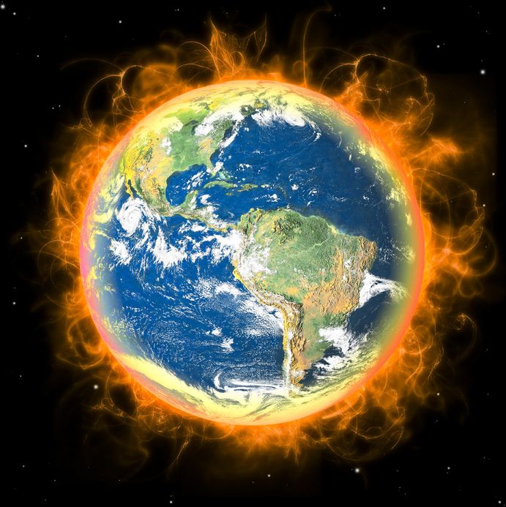
Ascended
Exalted
END
“Last days” (Heb. 1:1-2)
KINGDOM (Col. 1:13)
CHURCH (1 Tim. 3:15)
1 Cor. 15:23-26
Matt. 25:31-46
Judgment
Dan. 2:44-45
Mk. 1:14-15
Mark 9:1
Resurrection
HEAVEN
Matthew 16:16-19
HELL
The Bible

Slide 10
When Christ Returns
Personal and visible
Resurrection of all
Living changed
World destroyed
Rapture

Slide 11
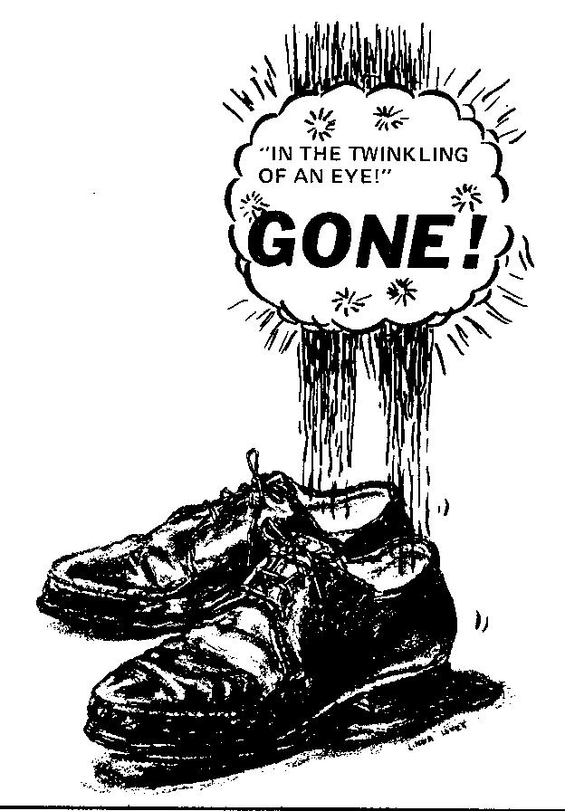
When Christ Returns
Judgment of all
Kingdom delivered up
Punishment
God reigns forever
Rapture

Slide 12
Be Comforted (1 Thess. 4:18)
Rapture gives false hope
Do not fear future
Do not doubt the truth
Christ can come any time
Live holy, 2 Peter 3:11, 14
Rapture

