Slide 1

The Kingdom Has Come
The Kingdom of God in Luke
Scripture Reading: Luke 17:20-25

Slide 2
The Kingdom of God in Luke
Luke portrays Jesus as fulfilling OT prophecies of the Messiah’s kingdom, Luke 12:31-32
  Kingdom is not postponed
  Kingdom is not an earthly reign of 1,000 years
  Kingdom is not part of a renovated earth
  Preached (8:1), Coming (11:2), Near (21:31-32; Matt. 3:2; Mk. 1:15)

Slide 3
The Kingdom of Prophecy
Old Testament
New Testament
Matthew 16:18-19
Kingdom
Church
“Your kingdom come” (Luke 11:2)

Slide 4
The Kingdom of Prophecy
OT Prophecy
Luke’s Fulfillment
King born of virgin
  Isaiah 7:14
  Isaiah 9:6-7
Luke 1:30-35 (2:7, 11)
  Virgin bears Son
  Throne of David
  Son of God and Savior
Kingdom has come!

Slide 5
The Kingdom of Prophecy
OT Prophecy
Luke’s Fulfillment
King on the throne
  2 Samuel 7:13
  Psalms 2:6-7
  Psalms 110:1-2
Sovereign rule
  Throne, 1:32-33
  Power, 22:67-70
  Exalted, 24:51 (Acts 2:33)
The kingdom has come!

Slide 6
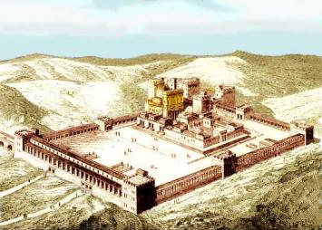
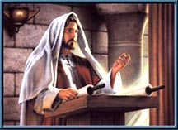
The Kingdom of Prophecy
OT Prophecy
Luke’s Fulfillment
Mountain of Lord’s house established
and preached
  Isaiah 2:2-3
Kingdom preached
  Jesus, 4:43 | Good news, 8:1
  Others sent, 9:2, 60
  Since John, 16:16
  From Jerusalem, 24:47
The kingdom has come!

Slide 7
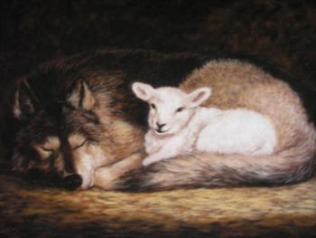
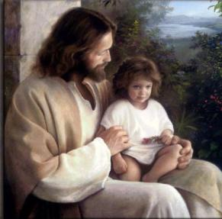
The Kingdom of Prophecy
OT Prophecy
Luke’s Fulfillment
Nature of peace, righteousness, unity and knowledge
  Isaiah 2:4
  Isaiah 11:1-5, 6-9
Blessed kingdom not of this world
  Poor in spirit, 6:20
  Within you, 17:20-21
  As a little child, 18:16-17
The kingdom has come!

Slide 8

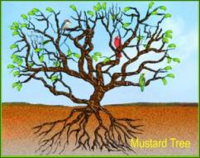
The Kingdom of Prophecy
OT Prophecy
Luke’s Fulfillment
Universal (all nations)
  Isaiah 11:10-12
Kingdom would grow and permeate the world, 13:18-21 (Acts 1: 6-8; 2:5); Rom. 11:5, 11
The kingdom has come!

Slide 9
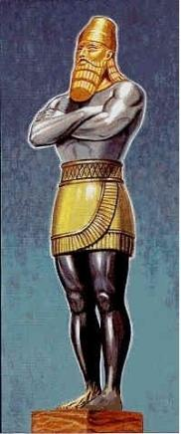
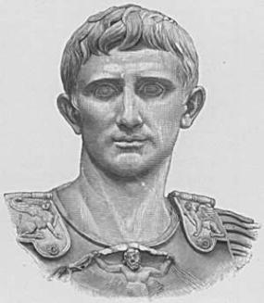
The Kingdom of Prophecy
OT Prophecy
Luke’s Fulfillment
When? “In the days of these kings”
  Daniel 2:44-45
  Babylon | Medes-Persians
  Greece | Rome
Roman empire, 2:1; 3:1
  Life of hearers, 9:27
  Near, 10:9, 11 | Come, 11:20
  Sign of His power, 21:31-33 (24-28)
The kingdom has come!

Slide 10
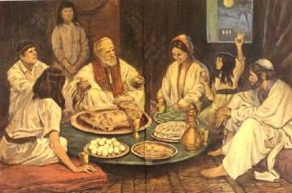

The Kingdom of Prophecy
OT Prophecy
Luke’s Fulfillment
Fulfilled in kingdom
  Passover, Exo. 12:7-13
  Fountain for sin,
  Zech. 12:10; 13:1
In the kingdom…
  Fulfilled, 22:15-18
  Christ’s blood
    Shed for you, 22:19-20
    Memorial, 1 Cor. 11:23-26
The kingdom has come!

Slide 11
The Kingdom of Prophecy
Old Testament
New Testament
Colossians 1:13-18
Kingdom
of God
Church of Christ
Acts 2:41, 47;
Eph. 1:20-23
The kingdom has come!
Acts 1:6; 3:19-26; Hebrews 12:22-23, 28

