Slide 1

Why Pray?
Scripture Reading: Psalm 34:15-19

Slide 2
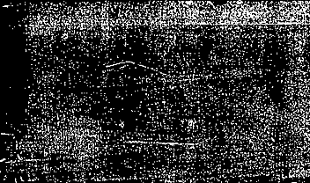
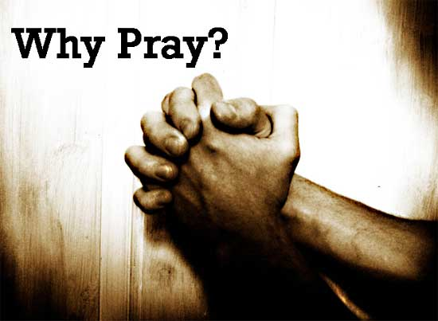

“What’s the use in praying?”
Not escape hatch
Not a “wish list”
Expressions of trust/dependency on our Father, Luke 11:5-8; 18:1

Slide 3
Why Pray?

Slide 4

Because Jesus Taught His Disciples to Pray
Jesus prayed, Luke 11:1
He taught His disciples to pray, Luke 11:2-4

Slide 5
Because
We Are Commanded to Pray
Without ceasing,
1 Thessalonians 5:17
Continuing steadfastly in prayer, Romans 12:12

Slide 6
Because
Prayer Expresses Our Faith in God
God sees, hears and delivers, Psalm 34:15-19
Dependency on God,
Matthew 7:7-8
Without doubt, Matthew 21:20-22; James 1:5-8
Trust in God, 1 Tim. 5:5

Slide 7
Because God Hears Our Prayers
Psalm 34 is applied to us, 1 Peter 3:12
Confident when we ask according to His will,
1 John 5:14

Slide 8
Because God Answers Our Prayers
When we respect
God and obey Him,
1 John 3:22
We have our petitions,
1 John 5:15

Slide 9
Because Prayer Keeps Our Focus on God and on Others
Faithful prayer replaces anxiety with thankfulness and peace, Phil. 4:6-7
Pray for others, 1 Thess. 5:25; 1 Tim. 2:1-2
Pray for one another, James 5:16

Slide 10
God’s Answers to Our Prayers

Slide 11
God’s Answers are Good
Father and his son, Matthew 7:9-10
Good gifts, Matthew 7:11

Slide 12
God’s Answers are According to His Will
“As you will,”
Matthew 26:39, 42
We ask according to God’s will, because that is how He answers us,
1 John 5:14-15

Slide 13
God’s Answers are According to His Will
His answers do not and will not violate His word
We express agreement with His will when we pray “your will be done,” “in the name of…,” and “Amen”

Slide 14
God’s Answers are According to His Will
What about when a loved one dies? (answer is “no”)
  God’s will is that we both live and die, Eccl. 3:1-8
  When and how death comes is left to God’s providence and to life’s uncertainties

Slide 15
God’s Answers are According to His Will
Death’s sorrow may be exactly what I need to secure my faith in God
  Jesus learning obedience through suffering, Hebrews 5:7-8

Slide 16
God’s Answers are According to His Will
Pain that is not taken away may be just what I need to teach me to rely on God more completely, 2 Corinthians 12:8-10

Slide 17
God’s Answers are According to His Will
Joyful blessing is a
time for humble thanksgiving, not boastful self-congratulations,
1 Thessalonians 5:17-18

Slide 18
Faith Leads Us to Accept His Answers
Even when they differ from our pleadings,
2 Corinthians 12:8

Slide 19
Not to make demands of God
Child’s dependent appeal to Father
A hopeful request and thankful acknowledgement
Faith in action

