Slide 1

Our Relation to Jesus
Hebrews 3:1-6

Slide 2
“‘These people draw near to Me with their mouth, and honor Me with their lips, but their heart is far from Me. And in vain they worship Me, teaching as doctrines the commandments of men.’” Matthew 15:8-9
“…And their fear toward Me is taught by the commandment of men.” Isaiah 29:13
How close is your heart to the Lord?
How real is Jesus to you?
2

Slide 3
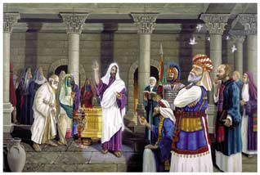
Jesus: The Apostle Of Our Confession (Hebrews 3:1)
Sent by Father, John 5:36; 7:25-29 (31)
Sent to speak the word of God, John 3:34
Relieve sinners, Luke 4:16-21
Eternal life / Judge, John 12:48-50
3

Slide 4
Jesus: The Apostle Of Our Confession (Hebrews 3:1)
Savior of world, 1 John 4:14
To prevent death and give life, John 3:12-17; 17:3
Sent His apostles into the world in the same fashion, John 20:21
4

Slide 5
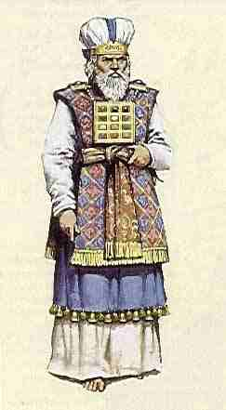
Jesus: The High Priest Of Our Confession (Hebrews 3:1)
Men
Appointed to offer gifts and sacrifices (Aaron), Hebrews 5:1, 3-4
Son of God
Appointed by God’s oath, He offered Himself, Hebrews 3:2; 5:5-6, 10; 7:20-21, 25-28; 8:3; 9:11-14, 24-26
5

Slide 6
Jesus: The High Priest Of Our Confession (Hebrews 3:1)
Men
Compassion for sinners, Hebrews 5:2
Son of God
Merciful and faithful, Hebrews 2: 17-18; 4:14-16
6

Slide 7
Jesus: The Son Over God’s House (Church) (Hebrews 3:2-6)
Christians are BRETHREN of Christ, Hebrews 2:11-12
One Father, Hebrews 2:11 (Gal. 4:4-7)
Jesus made like us, Hebrews 2:13-17
Those who do Father’s will, Matt. 12:46-50
7

Slide 8
Jesus: The Son Over God’s House (Church) (Hebrews 3:2-6)
Christians are PARTAKERS of Christ, Hebrews 3:14 (fellowship)
metochos (1:9): Partaker, partner, companion, fellow (Hebrews 3:1; Luke 5:7)
8

Slide 9
Jesus: The Son Over God’s House (Church) (Hebrews 3:2-6)
In the Church we are FRIENDS of Christ, John 15:14
When we obey Him, Matthews 28:20
9

Slide 10
Jesus Is Not Ashamed To Call Us His Brethren (Hebrews 2:11)
Will we be ashamed of Him? Mark 8:38
Of His testimony? (2 Tim. 1:8; Rom. 1:16)
Of suffering for Him? (2 Tim. 1:12)
Of being a Christian? (1 Pet. 4:16)
Partake of Christ: Hold the confidence and joy of hope firm to the end, Hebrews 3:6, 14
10

