Slide 1

Why Are You Angry?
Scripture Reading:
James 1:19-22

Slide 2
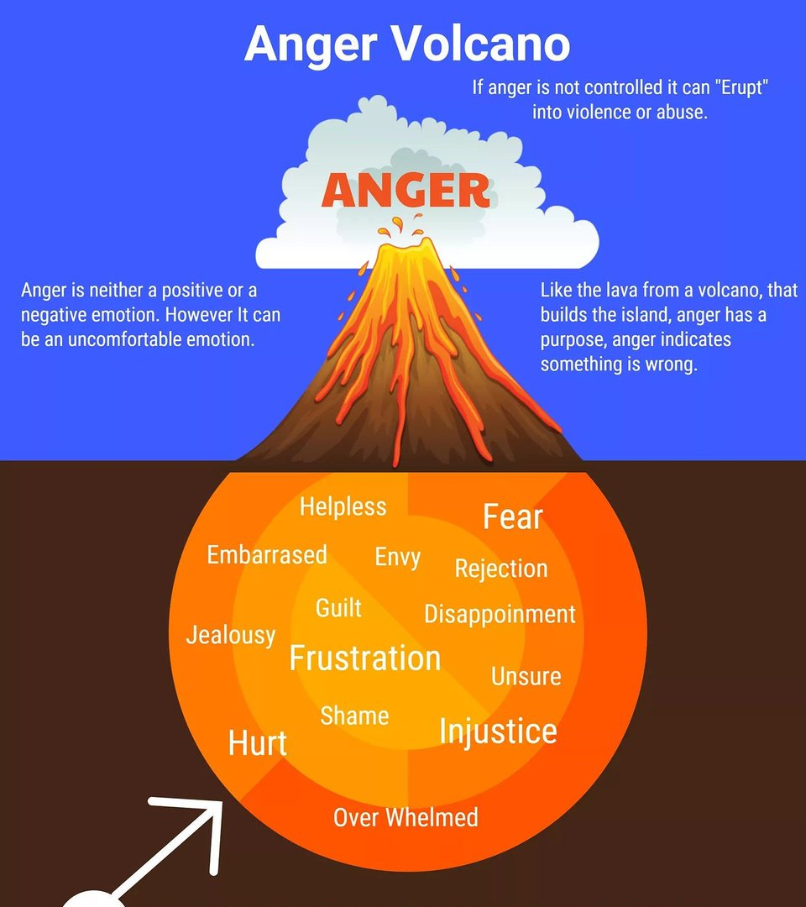
Anger is Triggered by Something
Why Are You Angry?
Col. 3:8
Eph. 4:31
Sources
Genesis 30:1-2

Slide 3
Anger Develops and Erupts from Many Sources

Slide 4

When Others Don’t Do What We Want
Numbers 24:10
A control issue
  Marriages (Col. 3:18-19)
  Parents and children (Ephesians 6:1-4)
  Churches (3 John 9-10)
Control ourselves,
2 Peter 1:5-6; Gal. 5:23

Slide 5
Envy, Jealousy and Selfishness
Genesis 4:3-7
Pride
  “I deserve that too/more!”
  “I’m better than he/she is!”
Humble contentment prevents anger’s eruption, Philippians 4:11-13

Slide 6
Guilt and
Shame
Acts 7:51-54
Deflective and defensive
  Avoid accountability
Overcome conceit
and pride
  Acknowledge our faults,
  2 Samuel 12:5-7, 13; Psalm 32:8-9

Slide 7
Frustration
2 Samuel 6:6-9
Refuse God’s ways
  Self-importance,
  Isaiah 55:8
“Your will (not mine)
be done”

Slide 8
When Our Expectations are not Met
2 Kings 5:10-13
Arrogance / Superiority
  God’s expectations must be our overriding concern

Slide 9
When We Have Been Sinned Against
Proverbs 25:23
Hurt, injustice, unloved
Commit yourself to God’s judgments,
1 Peter 2:21-23
  Be longsuffering,
  2 Corinthians 6:3-6

Slide 10
Unresolved Issues
Matthew 5:21-26
Bitterness, malice, etc.
Take the initiative
  Address and solve, Matthew 5:23
  Quickly reconcile, Matthew 5:24-25

Slide 11
Know the Dangers of Anger and Refuse Them

Slide 12

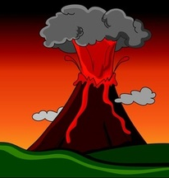
Know the Dangers of Anger and Refuse Them
Foolishness, Proverbs 14:17
Drives people away,
Proverbs 21:19
Aggravates problems and increases sin, Proverbs 29:22
Rests in the bosom of fools, Ecclesiastes 7:9

Slide 13
God Shows Us How to Be
Slow to Anger
Psalm 103:8-12
Mercy and grace, v. 8
Does not hold grudges, v. 9
Not given to pay back, v. 10
Magnifies mercy, v. 11
Abundantly forgives, v. 12

Slide 14
Learn Discretion
Proverbs 14:29; 19:11; 29:11
Overcome the impulses that lead
to anger
Grow in understanding, prudence, wisdom, self-control

