Slide 1
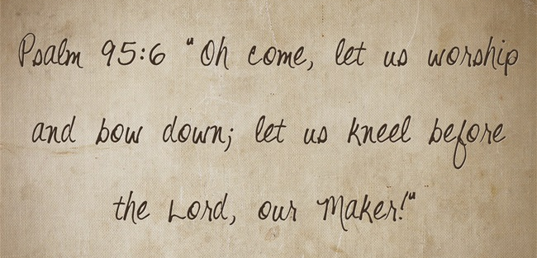


Slide 2

Encourage the Encouragers
Scripture Reading:
1 Thessalonians
5:12-22

Slide 3

Daily Encouragement
Heb. 3:12-13; 10:24 2 Corinthians 1:3-5
3

Slide 4

Ways to Encourage One Another
Urge each other to trust in God, Hebrews 13:5-6
  Emphasize faithfulness,
  2 Chron. 35:1-2; Acts 14: 21-22; 15:41; 18:23
  Godly living, obedient service, faithful worship
4

Slide 5
Ways to Encourage One Another
Assist each other physically and spiritually, Matthew 25:34-40
  Physical, James 5:14
  Spiritual, Jude 20-23
5

Slide 6
Ways to Encourage One Another
The weak and the strong, Deuteronomy 1:38
  Family relationship, Gal. 6:2; James 5:19-20; 1 Jno. 3:16-18
  Love, 1 Peter 2:17
  Everyone who serves
  Everyone who can serve
6

Slide 7
Encouraging One Another
Requires knowing each other, 2 Cor. 11:28-29
  Body, 1 Cor. 12:15-16, 24-25
  Share life and eternity, Romans 12:15-16
  Extend beyond familiar, Matt. 5:46-47; Lk. 14:12-14
Romans 1:11-12
7

Slide 8
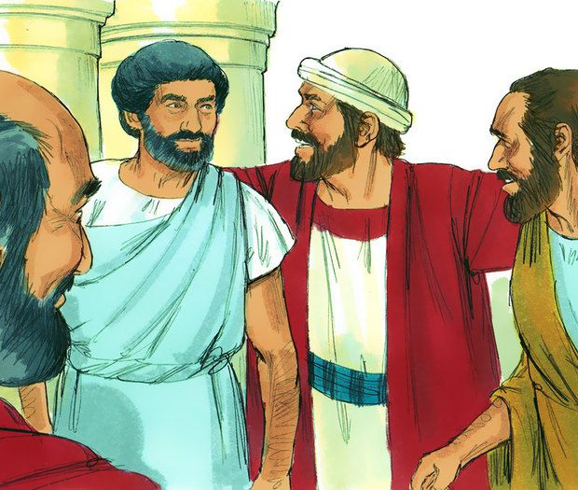
Barnabas, Son of Encouragement
Acts 4:36-37
Acts 11:21-24
Qualities in Barnabas…
  Generous (4:37)
  Unselfish (4:37; 5:1-2)
  Devoted (11:22)
  Perceptive (11:23)
  Good (11:24)
  Full of H.S. & faith (11:24)
8

Slide 9
Our Spiritual Responsibility
Encouragers look for opportunities to encourage
  Impossible to be an encourager in isolation, in silence, and with a lack of interest in others
  Rewarded, Matthew 10:41-42
Ephesians 4:16
9

Slide 10
Sons and Daughters of Encouragement
Ephesians 4:16
Are made through deliberate decisions…
  To be strong in the faith
  To work hard
  To be perceptive of needs
  To be devoted to Christ
10

