Slide 1
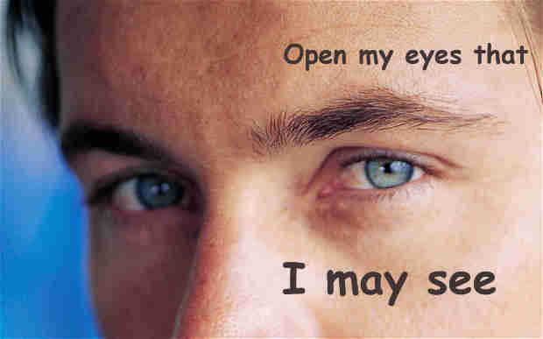
Scripture Reading: 2 Kings 6:12-18
(Part 1)

Slide 2
Open Our Eyes
Spiritual blindness, John 9:39-41
Let in light, Matthew 6:22-23

Slide 3
See the Invisible God
His presence (creation), Romans 1:20
His character and will (Jesus), Colossians 1:15
His purposes and power through trials, 1 Peter 1:6-9

Slide 4
Faith in the unseen, Matthew 26:52-53
Heavenly host at the ready, 1 Kings 22:19-23
Angels serve God for us, Matt. 18:10; Heb. 1:14
God’s providence and sovereignty
Army of God
2 Kings 6:13-18

Slide 5
Faith that Christ acts to guard our souls
Elisha and servant, 6:18
Helper, Hebrews 13:5-6 (2:17-18)
God is for us, Rom. 8:31-39
Lift up our eyes, Psalm 121
Army of God
2 Kings 6:13-18

Slide 6
“Blessed are those who have not seen and yet have believed.” (John 20:29)

