Slide 1
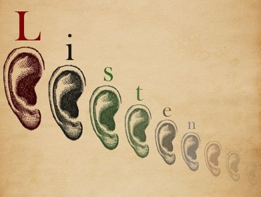

Ears to Hear
Scripture Reading
Proverbs 22:17-21
Part 1

Slide 2
“Ears to Hear”
“Take heed how you hear,” Luke 8:18
Parable of the sower and the seed, Luke 8:8-15, 16-17
Listening requires the right heart
Ears to hear…Heart to hear (to know)

Slide 3
“Ears to Hear”
God has spoken to us – Do we have ears to hear? Hebrews 1:1-2
Attention, respect, commitment to understand, Eccl. 5:1; Prov. 20:12; Matthew 13:9, 13-18
Hear and do, Exodus 15:26; Deuteronomy 4:1-2; Matthew 7:24-25

Slide 4
Ears that Listen to…
God by listening to His word, Luke 21:38
Read, learn, and obey the Bible for faith, Romans 10:16-17
To follow righteousness, Isaiah 51:1, 4, 7
Be careful listeners, Luke 19:47-48

Slide 5
Ears that Listen to…
The reproof of our sin, Proverbs 15:31-33; 25:11-12 (2 Timothy 3:16-17; Luke 17:3)
To be in the way of life, Proverbs 10:17
To avoid stupidity, Proverbs 12:1
To be wise (not stubborn), Proverbs 17:10
To avoid spiritual death, Proverbs 15:10

Slide 6
Ears that Listen to…
Wise counsel, Proverbs 8:32-36 (2:1-2; 5:1)
Who counsels you? Proverbs 18:15; 19:20
Are you able to receive counsel? Proverbs 29:1
Take counsel from all who wisely point us to God, Proverbs 24:6 (15:22)
Jesus (Counselor), Isaiah 9:6; John 6:67-69

Slide 7
“He who has ears to hear, let him hear” Matthew 13:9
An open heart to God’s word
Listen, examine, and correct ourselves according to truth
If not, then we will not understand and be saved, Matthew 13:13-16

