Slide 1
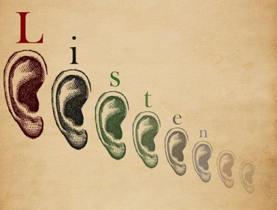
Ears to Hear
Scripture Reading
Ephesians 4:11-16
Part 2

Slide 2
Ears to Hear
The word of God
The reproof of sin
Wise counsel
Review - Part 1

Slide 3
Ears to Hear
Listening to each other is vital to “keep the unity of the Spirit in the bond of peace,” Ephesians 4:3, 15-16
Listening is about understanding what we hear, John 8:43

Slide 4
Things that Keep Us from Listening
Poor listening skills, Ecclesiastes 5:1-3
Why do we have trouble listening effectively to advance meaningful understanding and communication?

Slide 5
“We don’t listen to understand – we listen to reply.”

Slide 6
Things that Keep Us from Listening
Our own sin, John 8:44-47
Causes us to “stop our ears,” Acts 7:54-59
Heart given over to sin does not listen to God’s truth, 1 Corinthians 2:14 (Romans 8:7)
Must commit to hearing and doing God’s word, Ezekiel 33:30-33

Slide 7
Things that Keep Us from Listening
Hard, unrepentant heart, Matthew 13:14-16
Pharisees toward Jesus, Luke 11:52-54
Accept daily exhortations, Hebrews 3:7-8, 13
Prejudiced hearts reject truth without giving it a respectful hearing, Acts 22:21-23 (17:10-12)
Day of wrath prompts hearing, Romans 2:5-6

Slide 8
Things that Keep Us from Listening
Spiritual shallowness of self-interest, Matthew 13:19-22
Hearts closed by carelessness, indifference, and a lack of attention to spiritual things
Use time, resources, and opportunities to become better listeners, Matthew 6:33 (Ephesians 4:11-16)

Slide 9
Things that Keep Us from Listening
Anger, James 1:19-20
Not able to listen when anger controls us, Proverbs 12:15-16
Cannot communicate with an angry person, Ephesians 4:29, 31

Slide 10
Things that Keep Us from Listening
Pride, Proverbs 4:5-8; 11:2; 18:12-13
Arrogant conceit refuses to be taught and to admit any wrong
Prevents accepting sound teaching of God’s word and wise advice, Proverbs 15:31-33
Humility essential for listening, 1 Peter 5:5-6

Slide 11
Ears to Hear
Love listens, 1 Corinthians 13:4-8
Hear and do God’s word, James 1:21-25
Wisdom listens to and obeys word of Christ
To save ourselves, Acts 2:40-41 (Matt. 7:24-25)
To help each other, 1 Corinthians 1:10

