Slide 1
Throwing Rocks
Scripture Reading: John 8:1-11

Slide 2
Throwing Rocks
Figuratively thrown at Jesus, John 8:1-9
Means of execution (Law of Moses)
Implied the witnesses were guiltless, Deuteronomy 17:6-7
Men in John 8 were not free of guilt

Slide 3
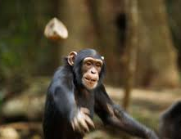
Why throw rocks?
“He who is without sin among you, let him throw a stone at her first.” (John 8:7)

Slide 4
Hypocrisy throws rocks
While ignoring its own sin, John 8:7-9; Romans 2:1-2 (Matthew 7:1-5)
At the innocent, Matthew 15:1-3
Fails to show mercy, Matthew 12:1-2, 7
Fails to practice what is preached, Romans 2:17-24

Slide 5
Hypocrisy throws rocks
Why do hypocrites throw rocks?
Deflect attention from their hypocrisy, Matthew 23:23, 27-28
Present as genuine, Matthew 23:24-25
Seen and honored, Matthew 23:5-7, 11-12

Slide 6
pride throws rocks at the humble (Luke 18:11; Psalm 10:2)
Dominate and Control people and situations, James 4:10-12
Due to Self-Righteousness, Luke 18:9
Justify self, Proverbs 30:11-14

Slide 7
pride throws rocks at the humble (Luke 18:11; Psalm 10:2)
Due to Envy, Matthew 27:18; Acts 13:45
Companion of bitterness and self-seeking, James 3:14
Let us not become conceited, provoking, envious, Galatians 5:26

Slide 8
error throws rocks at truth (and those who walk in truth)
Destroy Faith in Word of God, Hebrews 4:12; 2 Timothy 3:16-17; 1 Cor. 14:37
Doubt it is from God, Genesis 3:1
Misapply, Matthew 4:5-6 (Psalm 119:160)
Truth prevails and protects us

Slide 9
error throws rocks at truth (and those who walk in truth)
Make Room for Error, 2 Peter 3:1-4
Discredit truth, Jude 4
Kill the messenger, Acts 7:54 (6:10)
Fear and intimidation, Acts 4:18, 21; 5:40

Slide 10
error throws rocks at truth (and those who walk in truth)
Shield itself from Exposure and Accountability, 3 John 9-10
Truth exposes error, John 3:19-20
Error blames righteousness for its troubles, 1 Kings 18:17-18

Slide 11
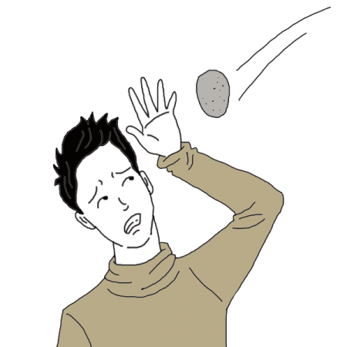
Throwing rocks (Unrighteous judging and condemnation)
“Therefore let us not judge one another anymore, but rather resolve this, not to put a stumbling block or a cause to fall in our brother’s way.” (Romans 14:13)
“For with what judgment you judge, you will be judged; and with the measure you use, it will be measured back to you.” (Matthew 7:2)

