Slide 1
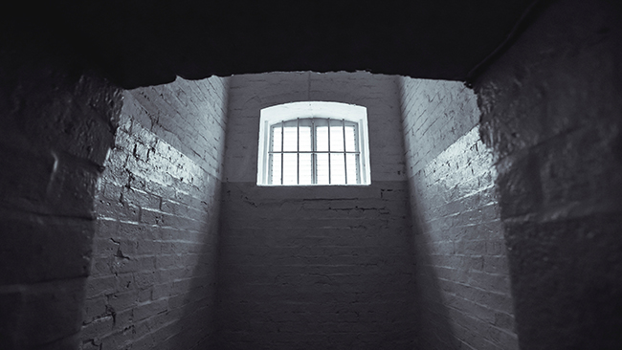
Are We Ready To Suffer?
1 Peter 4:12-16

Slide 2
New Testament Christians
Taught to accept suffering and rejoice in Christ
Blessed, Matthew 5:10-12
Jesus and apostles, John 15:18-21
Christ suffered without sinning
Our example to follow, 1 Peter 2:21-24

Slide 3
What did suffering for faith look Like in the Old Testament?
3

Slide 4
Hebrews 11:35-39
“Of whom the world was not worthy”
Joseph
David
Prophets of God
Faithful men and women

Slide 5
What did suffering for faith look Like in the New Testament?
5

Slide 6
New Testament Persecutions
Jesus, Luke 9:22
Stephen, Acts 6:10-14; 7:54-60
Jerusalem church, Acts 8:1-4; 9:1 (Heb. 10:32-34)
Apostles, Acts 5:40; 12:1-2; 1 Cor. 4:9-13
Faithful Christians, 1 Peter 3:13-17; 4:16; Revelation 2:10

Slide 7
Are We Ready to Suffer?
7

Slide 8
The Demands of Suffering for Christ
Inclined to overestimate readiness, Luke 22:33-34; Matt. 26:40
Deny ourselves, Luke 9:22-23 (Rev. 12:11)
Priority of kingdom citizenship, Philippians 3:20; Matthew 6:33-34
Value heaven more than this world, Matthew 6:20-21
Faith that confidently endures, Hebrews 10:35-36

Slide 9
New Testament Christians
Godliness arouses persecution, 2 Timothy 3:12
Ancient brethren died for faith, Revelation 6:11
Christ will right every wrong, Revelation 6:10
Keep patiently fighting the good fight of faith, Revelation 14:11-13
Victory is certain in Christ! Revelation 17:14; 20:4

