Slide 1
False Things on the Broad Way
Matthew 7:13-29

Slide 2
James 1:26-27
26 If anyone among you thinks he is religious, and does not bridle his tongue but deceives his own heart, this one’s religion is useless.
27 Pure and undefiled religion before God and the Father is this: to visit orphans and widows in their trouble, and to keep oneself unspotted from the world.

Slide 3
False Prophets Matthew 7:15-20
Really exist, 1 John 4:1
In Israel, Jeremiah 14:14-16; Ezekiel 13:1-7
First century, Matthew 24:5
Today, 2 Peter 2:1-3
Deceptive teachings, Jeremiah 14:14 (15)
Own heart, Jeremiah 23:16
Serve Satan, 2 Corinthians 11:13-15

Slide 4
False Prophets Matthew 7:15-20
Known by fruit, Deuteronomy 18:21-22
Predictions fail, Jeremiah 27:14; 28:1-3
Trust lies and taught rebellion, Jeremiah 28:15-17
Beware of false prophets today:
How to be saved
The return of Jesus and His kingdom
God and heaven

Slide 5
False faith Matthew 7:21-23
Faith becomes false when we practice lawlessness, Matthew 7:22-23 (Jude 4)
There is only one faith, Ephesians 4:5
The gospel, Romans 1:16-17
Deliverance, redemption, Colossians 1:13-14
Hope of heaven when do the Father’s will

Slide 6
A False Foundation Matthew 7:24-27
False foundations include:
My conscience, Acts 23:1
Family faith, Matthew 10:37
Feelings, Jeremiah 10:23; 17:9
Experiences, Acts 8:9-11

Slide 7
Jesus Christ Matthew 7:28-29
Complete authority to…
Speak truth as God’s Prophet, Acts 3:22-23
Be the foundation of our faith, 1 Cor. 3:11
Judge our faith, 2 Corinthians 5:10

Slide 8
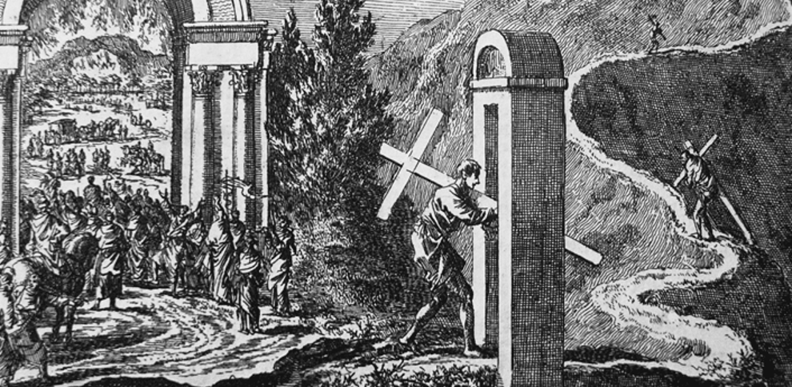
The strait (narrow) versus wide gate: etching by Jan Luyken (1649-1712) illustrating Matthew 7:13-14 in the Bowyer Bible

