Slide 1
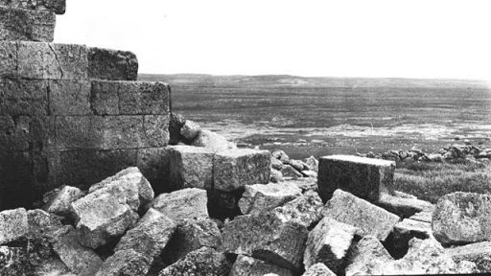

The Walls Came Tumbling Down

Slide 2
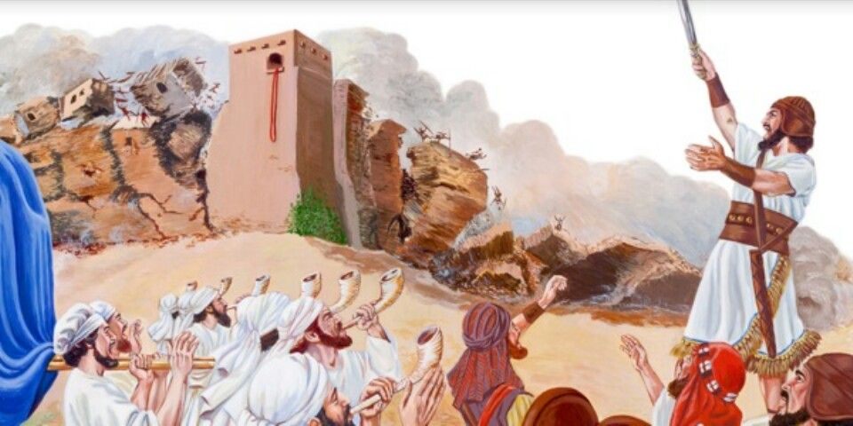

God’s Blessing of Victory, Joshua 6:2, 16, 20

Slide 3
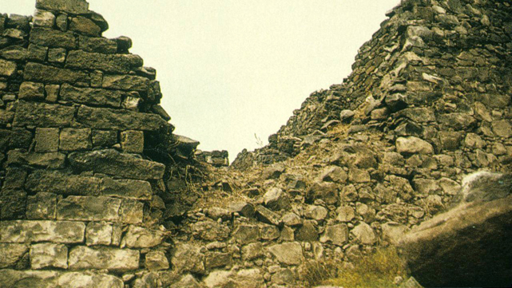
God’s Curse Against Sin, Deut. 28:47-48, 52

Slide 4
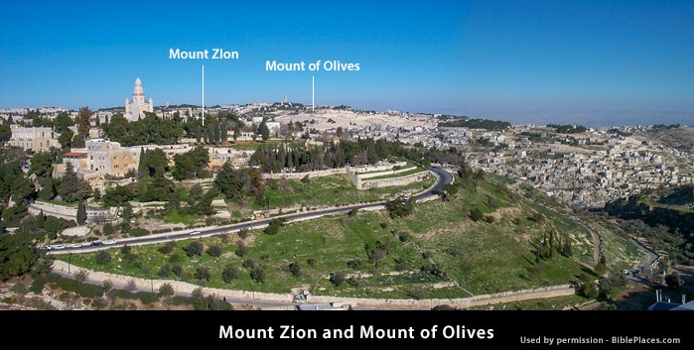
The Church
of Christ
(Heb. 12:22-23)
Her Walls are “Salvation,” Isaiah 26:1; 60:18; 62:6-7
[Blessing or Curse? Deut. 30:19-20; Heb. 12:28-29]

Slide 5
Walls Tumbled Down
Jericho
FAITH, Hebrews 11:30
  Stronger nations, yet Israel trusted God,
  Deut. 7:1; Joshua 1:5
  Trust God’s deliverance, 1 John 5:4; Eph. 6:10-11
Jerusalem
FAITHLESSNESS, Jer. 5:10-13
  Unbelief, Jer. 16:10-13
  Didn’t trust God; Trusted walls, Deut. 28:52;
  Lam. 4:11-12
  What do we trust and serve?

Slide 6
Walls Tumbled Down
Jericho
OBEDIENCE, Heb. 11:30 (10:39)
  Responsive and submissive to God’s commands, Luke 6:46; Hebrews 5:9
Jerusalem
DISOBEDIENCE, Jer. 16:11-12
  Idolatry and hypocrisy,
  Isaiah 29:13-14
  Sinful attitude toward
  God’s word, Ezek. 33:30-32
  Hear and obey, James 1:22

Slide 7
Walls Tumbled Down
Jericho
PURITY, Josh. 3:5; 5:7-9
  Set themselves apart from defilement
  Circumcision identified them as God’s people,
  2 Corinthians 6:17-18; Rom. 6:22 (Col. 2:11-12)
Jerusalem
DEFILEMENT, Lam. 1:8-9; Isaiah 59:1-4
  Sin breaches wall of protection, Ezekiel 42:20; 44:23 (2 Peter 2:20-22)
  Cleanse ourselves and be holy, 2 Corinthians 7:1

Slide 8
Walls Tumbled Down
Jericho
SELF-DENIAL, Josh. 6:3-4
  No small task
  Did not say, “Ridiculous!”
  (2 Kings 5:10-13)
  Willingly sacrifice,
  Luke 9:23
Jerusalem
SELF-INDULGENCE,
Ezekiel 7:19
  No protection in “day of the Lord’s wrath” (Zeph. 1:18)
  1 John 2:15-17 (Eph. 5:3-7)
  Self-control, James 4:1-4

Slide 9
Blessing and Curse Set Before Us
Deuteronomy 11:26-28; Romans 11:22
Victory in Christ
Faith, obedience,
purity, self-denial
Wrath of God
Faithlessness, disobedience, defilement, self-indulgence
The Church
Safety and Salvation
Isaiah 26:1-4; Hebrews 2:1-3

