Slide 1

“Where You Stand Depends On Where You Sit”
Scripture Reading: Psalm 26
Notes:
Be specific and direct in the title. Use the subtitle to give the specific context of the speech.
-The goal should be to capture the audience’s attention which can be done with a quote, a startling statistic, or fact. It is not necessary to include this attention getter on the slide.

Slide 2
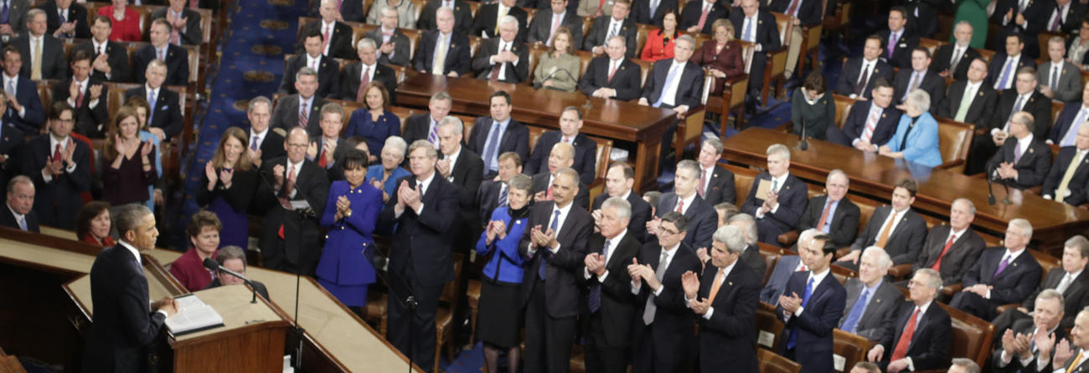
“Where you stand depends on where you sit.”

Slide 3
“Where you stand depends on where you sit.”
Tendency to see and
evaluate things based on
our relationships to them
Devil’s children, John 8:44-45
Christ’s sheep, John 10:26-27
“Your view of a situation is shaped by your personal relationship to it.” (Miles’s Law)
Notes:
Use the background points to post details that are not common knowledge, or that the audience will need to understand the context of the speech.
-Do not read these main points from the PowerPoint, instead elaborate on these points during the speech.

Slide 4
Our Relationships
Impact Our Beliefs
Notes:
Dedicate this entire slide to the thesis statement. It is the reason the speech is being given. Use this time to reveal the three main points of the speech (slides 4,5,6) as an overview for the direction of the speech:
-[type main point #1 here]
-[type main point #2 here]
-[type main point #3 here]
Be sure to transition to the first main point and the next slide.

Slide 5
Impact Convictions
Plan of salvation
One true church
M-D-R
LGBTQ
Church discipline
Immodesty
Religious traditions
Family and Friends
Matthew 10:34-37
Luke 14:26
Notes:
The title of main point #1 should be clear and concise. Each piece of evidence should be summarized for clarity and cited correctly. Do not simply read the pieces of evidence, but elaborate where needed.
[type notes for elaboration here]
Be sure to transition to main point #2 and the next slide.

Slide 6
Impact Convictions
Do not pit providing for family against obeying Christ
Worship and other vital responsibilities
Our Jobs
Matthew 6:25, 33
1 Timothy 5:8
Notes:
The title of main point #1 should be clear and concise. Each piece of evidence should be summarized for clarity and cited correctly. Do not simply read the pieces of evidence, but elaborate where needed.
[type notes for elaboration here]
Be sure to transition to main point #2 and the next slide.

Slide 7
Impact Convictions
What anchors your convictions?
  Word of God?
  2 Timothy 3:16-17
  Confidence in people? Luke 3:8-9
  Fear? John 12:42
  Love acceptance?
  John 12:43
Problem: Not Being
Converted to Christ
Luke 9:23
Notes:
The title of main point #1 should be clear and concise. Each piece of evidence should be summarized for clarity and cited correctly. Do not simply read the pieces of evidence, but elaborate where needed.
[type notes for elaboration here]
Be sure to transition to main point #2 and the next slide.

Slide 8
When We Sit with Christ,
We Will Stand With Christ
Notes:
Dedicate this entire slide to the thesis statement. It is the reason the speech is being given. Use this time to reveal the three main points of the speech (slides 4,5,6) as an overview for the direction of the speech:
-[type main point #1 here]
-[type main point #2 here]
-[type main point #3 here]
Be sure to transition to the first main point and the next slide.

Slide 9
Sit With Christ
All spiritual blessings, Ephesians 1:3
Stand against devil, Ephesians 6:11, 13, 14
Mind heavenly things Colossians 3:1-5
Heavenly Places
Ephesians 2:4-6
Notes:
The title of main point #2 should be clear and concise. Each piece of evidence should be summarized for clarity and cited correctly. Do not simply read the pieces of evidence, but elaborate where needed.
[type notes for elaboration here]
Be sure to transition to main point #3 and the next slide.

Slide 10
Be Careful Where You Sit, Because That Is Where You Will Stand
Psalm 1:1-2; 26:3-5, 11-12
Notes:
Dedicate this entire slide to the thesis statement. It is the reason the speech is being given. Use this time to reveal the three main points of the speech (slides 4,5,6) as an overview for the direction of the speech:
-[type main point #1 here]
-[type main point #2 here]
-[type main point #3 here]
Be sure to transition to the first main point and the next slide.

Slide 11

Sit With
Unbelievers in Faithlessness
You will stand in darkness and spiritual death Ephesians 4:17-19
Notes:
The title of main point #1 should be clear and concise. Each piece of evidence should be summarized for clarity and cited correctly. Do not simply read the pieces of evidence, but elaborate where needed.
[type notes for elaboration here]
Be sure to transition to main point #2 and the next slide.

Slide 12
Sit With
The World in Immorality
You will stand condemned in sin Romans 1:32
Notes:
The title of main point #1 should be clear and concise. Each piece of evidence should be summarized for clarity and cited correctly. Do not simply read the pieces of evidence, but elaborate where needed.
[type notes for elaboration here]
Be sure to transition to main point #2 and the next slide.

Slide 13
Sit At
The Feet of Jesus
(learn His gospel)
You will stand up and obey Him
Acts 22:14-16
Notes:
The title of main point #1 should be clear and concise. Each piece of evidence should be summarized for clarity and cited correctly. Do not simply read the pieces of evidence, but elaborate where needed.
[type notes for elaboration here]
Be sure to transition to main point #2 and the next slide.

Slide 14
Sit With
Christ
in Salvation
You will stand
in God’s grace Romans 5:1-2, 3-4
Notes:
The title of main point #1 should be clear and concise. Each piece of evidence should be summarized for clarity and cited correctly. Do not simply read the pieces of evidence, but elaborate where needed.
[type notes for elaboration here]
Be sure to transition to main point #2 and the next slide.

Slide 15
Sit With
You will stand together in common faith
1 Cor. 14:26; 1:10
Eph. 4:5; Jude 3
1 Cor. 16:13 (2)
Christians in
True Worship
Notes:
The title of main point #1 should be clear and concise. Each piece of evidence should be summarized for clarity and cited correctly. Do not simply read the pieces of evidence, but elaborate where needed.
[type notes for elaboration here]
Be sure to transition to main point #2 and the next slide.

Slide 16
Jesus
“Where you stand depends
on where you sit.”
Words, John 6:68
Church, Eph. 2:6
Victory, Rev. 17:14
Notes:
The title of main point #2 should be clear and concise. Each piece of evidence should be summarized for clarity and cited correctly. Do not simply read the pieces of evidence, but elaborate where needed.
[type notes for elaboration here]
Be sure to transition to main point #3 and the next slide.

