Slide 1

Common to All
Scripture Reading: Ecclesiastes 7:13-20

Slide 2
World Focuses on Our Differences
Wealth, education, social class, gender, race
Comparing, commending, and condemning 2 Corinthians 10:12
Self-centered, destructive, and sinful
Equality v. Equity

Slide 3
Enter by the narrow gate; for wide is the gate and broad is the way that leads to destruction, and there are many who go in by it. Because narrow is the gate and difficult is the way which leads to life, and there are few who find it (Matthew 7:13–14).
Equality?
Equity?

Slide 4
Common to All
Man or woman?
1 Corinthians 11:11-12
Another race?
Acts 17:26
Bill Gates? Prov. 22:2

Slide 5
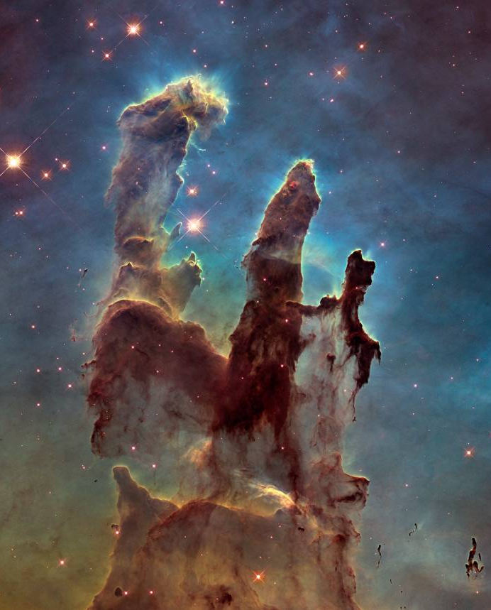
God Created Us All
Gen. 1:1, 26-27; 2:7, 21-23
Life, Acts 17:25
  -Gen. 1:28-29; 3:21; 9:3
We all benefit from God’s goodness,
Acts 14:17; 17:28

Slide 6

Inherently Equal Before God
ALL
Common to All
Image of God
Genesis 1:27
1 Samuel 16:7

Slide 7
Inherently Equal Before God
ALL
Common to All
Born Innocent
Deut. 1:39 (Eccl. 7:29)
Matthew 18:3-4; 19:14

Slide 8
Inherently Equal Before God
ALL
Common to All
Tempted to Sin
1 Cor. 10:12-13
James 1:14
Matthew 9:10-13

Slide 9
Inherently Equal Before God
ALL
Common to All
Choose to Sin
Romans 5:12 (3:23)
James 1:15-16
Luke 13:1-5

Slide 10
Inherently Equal Before God
ALL
Common to All
Need Salvation
John 3:16-17
Ephesians 2:1-3
Titus 2:11

Slide 11
Inherently Equal Before God
ALL
Common to All
Gospel is for All
Mark 16:15
Acts 10:34-35 (28)
Mark 16:16 (Acts 15:9, 11)

Slide 12
Inherently Equal Before God
ALL
Common to All
In the Church
Galatians 3:28-29
Col. 3:11; 1 Peter 2:9
Romans 12:3-5

Slide 13
Inherently Equal Before God
ALL
Common to All
Death
Hebrews 9:27
James 4:13-17

Slide 14
Inherently Equal Before God
ALL
Common to All
Justice from God
Romans 14:12
2 Corinthians 5:10
Acts 17:31

Slide 15
Judgment Seat of Christ
Inherently Equal Before God
Truth, 2:2
Inclusive, 2:3
All can repent, 2:4
Righteous, 2:5
Conduct, 2:6-10
Impartial, 2:11
Romans 2:2-11

Slide 16

What Does This Mean For Us?
Love neighbor
Live peaceably
Seek the lost

Slide 17
Common to All
Problem of sin
Remedy is Christ
Opportunity to be saved is now
Matthew 7:13-14

