Slide 1
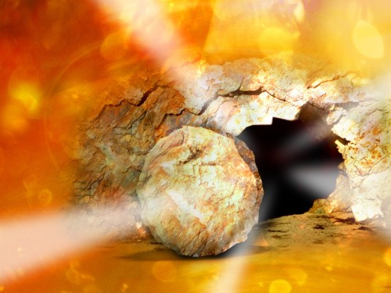
Scripture Reading: Matthew 28:1-8
The
Good News
of the
Resurrection

Slide 2
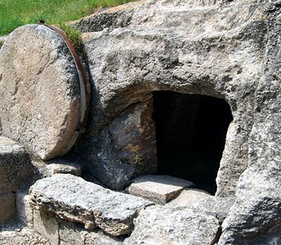
Evidence of the Resurrection
Empty tomb
Fulfilled prophecy
Eyewitnesses
Acts 10:38-43
1 Cor. 15:1-8, 14-20
Good News

Slide 3
Jesus is Lord
Declared Jesus is the Son of God, Rom. 1:3-4; Ps. 2:7 (Acts 13:32-33)
Lord, Acts 2:32-36
King, Psalm 110:1-2
Pilate’s sign, John 19:19
resurrection

Slide 4
Jesus is Lord
Implications, 1 Tim. 6:15
Complete and supreme authority, Matthew 28:18
Over rulers of men, Psalm 2:8-9 (John 19:11)
Respect and submit, Col. 3:17 (Luke 6:46)
resurrection

Slide 5
Validates His Claims
Nothing without it, Acts 5:35-38
Jesus spoke and acted as the very person of God
resurrection

Slide 6
Validates His Claims
Divine prerogatives, John 10:30-39
Forgive sins
Greater than the temple
Lord of the Sabbath
Authority over the Law
Fulfilled OT prophecy
Love Him more
resurrection

Slide 7
Validates His Claims
resurrection
Confirms His Deity
We have a moral imperative to make Jesus the center of our lives, John 20:27-31

Slide 8
God has not given up on us
Death: Sacrifice for sins, Hebrews 2:9 (1 John 2:2)
Resurrection: Victory over death, Revelation 1:18
resurrection

Slide 9
God has not given up on us
After His resurrection
Jesus showed His wounds and spoke “peace,” John 20:19-21
Wounds, Isaiah 53:4-6
Peace, Romans 5:8, 10
Our sinful hatred is answered with God’s sacrificial, forgiving love
resurrection

Slide 10
The Resurrection of Jesus
GOSPEL
(euangelion)
Used to signal good news of imperial victories of Caesar
Good news of our King’s victory over death, 1 Cor. 15:19-20, 56-57
10

