Slide 1

Scripture Reading: Ecclesiastes 7:13-18
A BALANCED LIFE

Slide 2
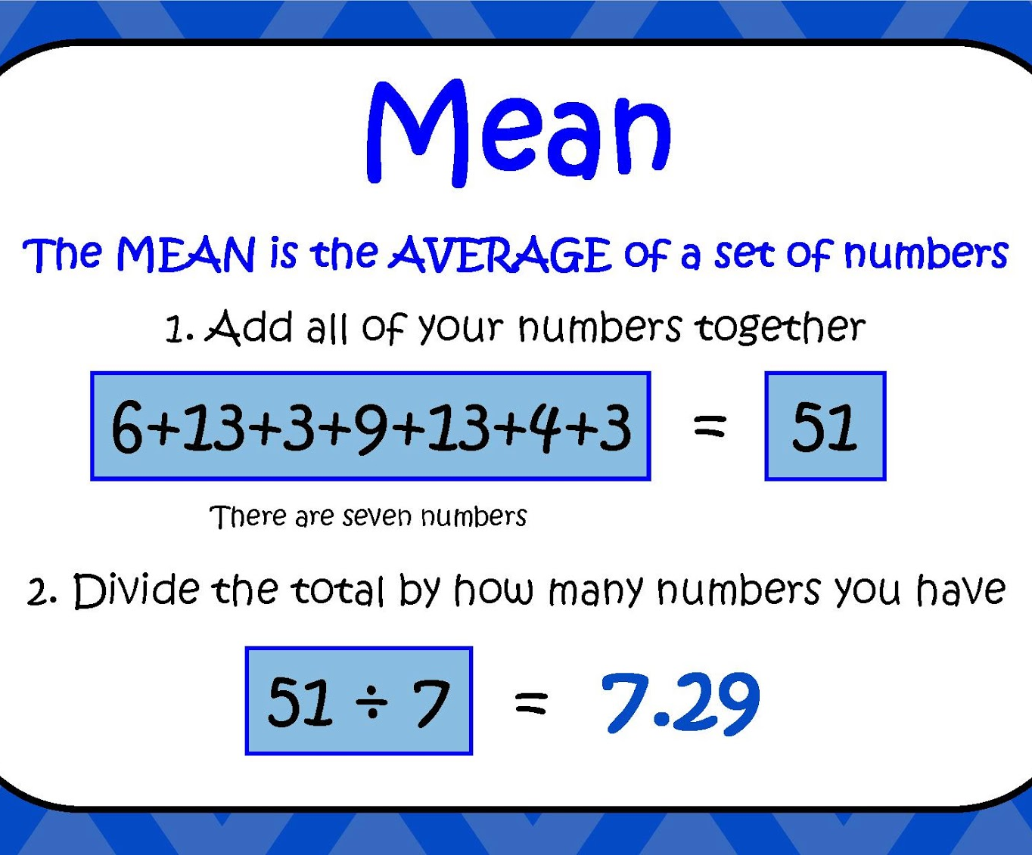
“Occupying the middle or intermediate position between two extremes”
Proverbs 25:16; 23:4-8

Slide 3
The Golden Mean
Ecclesiastes 7:16-17
Not riding the fence (morally, religiously)
Not compromising with error and sin
Not failing to be committed, 1 Kings 18:21
Living in the balance of truth, not extremism

Slide 4
Consider what happens to the righteous and the wicked
Ecclesiastes 7:15

Slide 5
Sometimes the Righteous Suffer and the Wicked Succeed on Earth
Solomon observed this, Eccl. 8:14; 9:11-12
Jesus lived this, 1 Peter 2:21-22
Israel complained against God because of it, Malachi 3:13-15
God-fearers discern correctly about this, Malachi 3:16-18 (2 Thess. 1:4-7)

Slide 6
Life’s Inequities Tempt Us To Overcompensate, driving us to Extremes
Ecclesiastes 7:16-18

Slide 7
Overly Righteous
(self-righteousness), Luke 18:9-14
Binding human traditions, Mark 7:8-13
Establishing our own way of righteousness, Romans 10:2-3

Slide 8
Overly Wise
(conceit of human wisdom), Romans 12:3
Becomes blind to truth, Romans 1:22;
1 Corinthians 1:18-24
Becomes blind to its own limitations and futility, Colossians 2:8, 21-23 (Eccl. 7:13)

Slide 9
Overly Wicked
(deliberate, ignores God), Psalms 10:4, 11; 14:1
Presumptuous, willful sin, Psalm 19:13;
Hebrews 10:26-27
Unattended sin gets worse and worse,
2 Timothy 3:13

Slide 10
Foolish Indifference
(non-committal)
Do not hate knowledge, Prov. 1:22 (2:1-5)
Avoid the complacency of irreverence,
Proverbs 1:29-33
Extremes are unwise and unfulfilling,
Ecclesiastes 7:16-17

Slide 11
Fearing God Brings Balance to Life

Slide 12
Living a Balanced Life
Fear God to avoid the pitfalls of extremes, Ecclesiastes 7:18
  Realistic and wise view of life on earth
  Focus on living with a fear of God – Balanced life, Ecclesiastes 8:12-13, 14-9:1

Slide 13
Living a Balanced Life
Fear and obey God, Eccl. 12:13-14
  Seek the righteousness God approves, Ephesians 4:20-24; 1 John 2:29; 3:7, 10
  Rely on wisdom from above, James 3:13-18

Slide 14
Living a Balanced Life
Fear and obey God, Eccl. 12:13-14
  Resist willful sin, 1 John 2:1; 1 Thess. 5:21-22
  Do not be foolish about sin, 1 John 1:8-10; Hebrews 2:1-3

Slide 15
Living a Balanced Life
Prosperity and adversity exist, Eccl. 7:13-14 (3:1); Job 2:9-10
  They exist so we will consider God, seek Him, and rely on Him instead of ourselves, Matthew 6:33-34

Slide 16
