Slide 1
Open Our Eyes that We May See
Scripture:
2 Kings 6:6-18

Slide 2
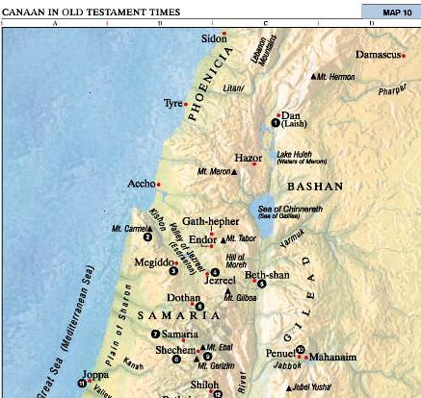
Syrian army with horses and chariots surround Elisha (2 Kings 6:13-15)
“Do not fear, for those who are with us are more than those who are with them.” (2 Kings 6:16)
SYRIAN ARMY
Open his eyes that he may see” (2 Kings 6:17)
God’s powerful deliverance (2 Kings 6:18-23)

Slide 3
Open Our Eyes that We May See!
Christians walk by faith, 2 Corinthians 5:7
Flee sin and pursue righteousness, 1 Timothy 6:11-12
Enemy is powerful and crafty, 1 Peter 5:8-9
God is all-powerful and all-wise, James 4:7; 1 John 4:4

Slide 4
Open Our Eyes that We May See
Create, Romans 1:18-21
Faith to know, honor, and thank Him
Save and protect, Exod. 14:13, 30
Battle rages, 2 Chron. 20:12, 15-20
See God’s power, Eph. 1:17-20
God delivers, Romans 8:31-39
Soul is safe, 2 Timothy 1:12
The Power of God

Slide 5
Open Our Eyes that We May See
Hebrews 4:12
Attribute of God, Deut. 32:4 (Exod. 34:6); John 1:14, 17; 14:6 (17:17)
To convict and save, John 16:8, 13; Romans 1:16
To protect us from our enemies, Ephesians 6:10-17
The Power of Truth

Slide 6
Open Our Eyes that We May See
To bring God’s blessings, Matthew 8:5-10 (13)
To activate God’s power, Luke 17:5-6; Mark 9:23
The Power of Faith

Slide 7
Open Our Eyes that We May See
1 Peter 4:8
Empowers us to forbear, forgive, and bind together, Colossians 3:12-14
To overcome evil with good, Romans 12:19-21 (2 Kings 6:21-23)
The Power of Love

Slide 8
Open Our Eyes that We May See
Colossians 3:12-17
Cords of love, peace, truth, and divine authority 1 Cor. 1:10; Eccl. 4:9-12
Weakness and sin of division, 1 Cor. 3:3-4; Gal. 5:13-15
The Power of Unity in Christ

Slide 9
Open Our Eyes that We May See
Matthew 18:21-27
Reflects God’s forgiveness of us, Ephesians 4:31-32 (Matthew 6:12, 14-15)
Power to heal, strengthen, and secure
Influence, Matt. 18:28-33
The Power of Forgiveness

Slide 10
God’s Great Power Surrounds Us
To save, defend, and secure
Believe and obey God – Have His strength in your life, Col. 1:9-11; Eph. 3:20-21
Will you walk by faith and be powerful in God?
Or will you walk with the world, lost and powerless?
Psalm 34:4-7

