Slide 1
Basic Principles
Scripture Reading:
Colossians 2:1-10

Slide 2
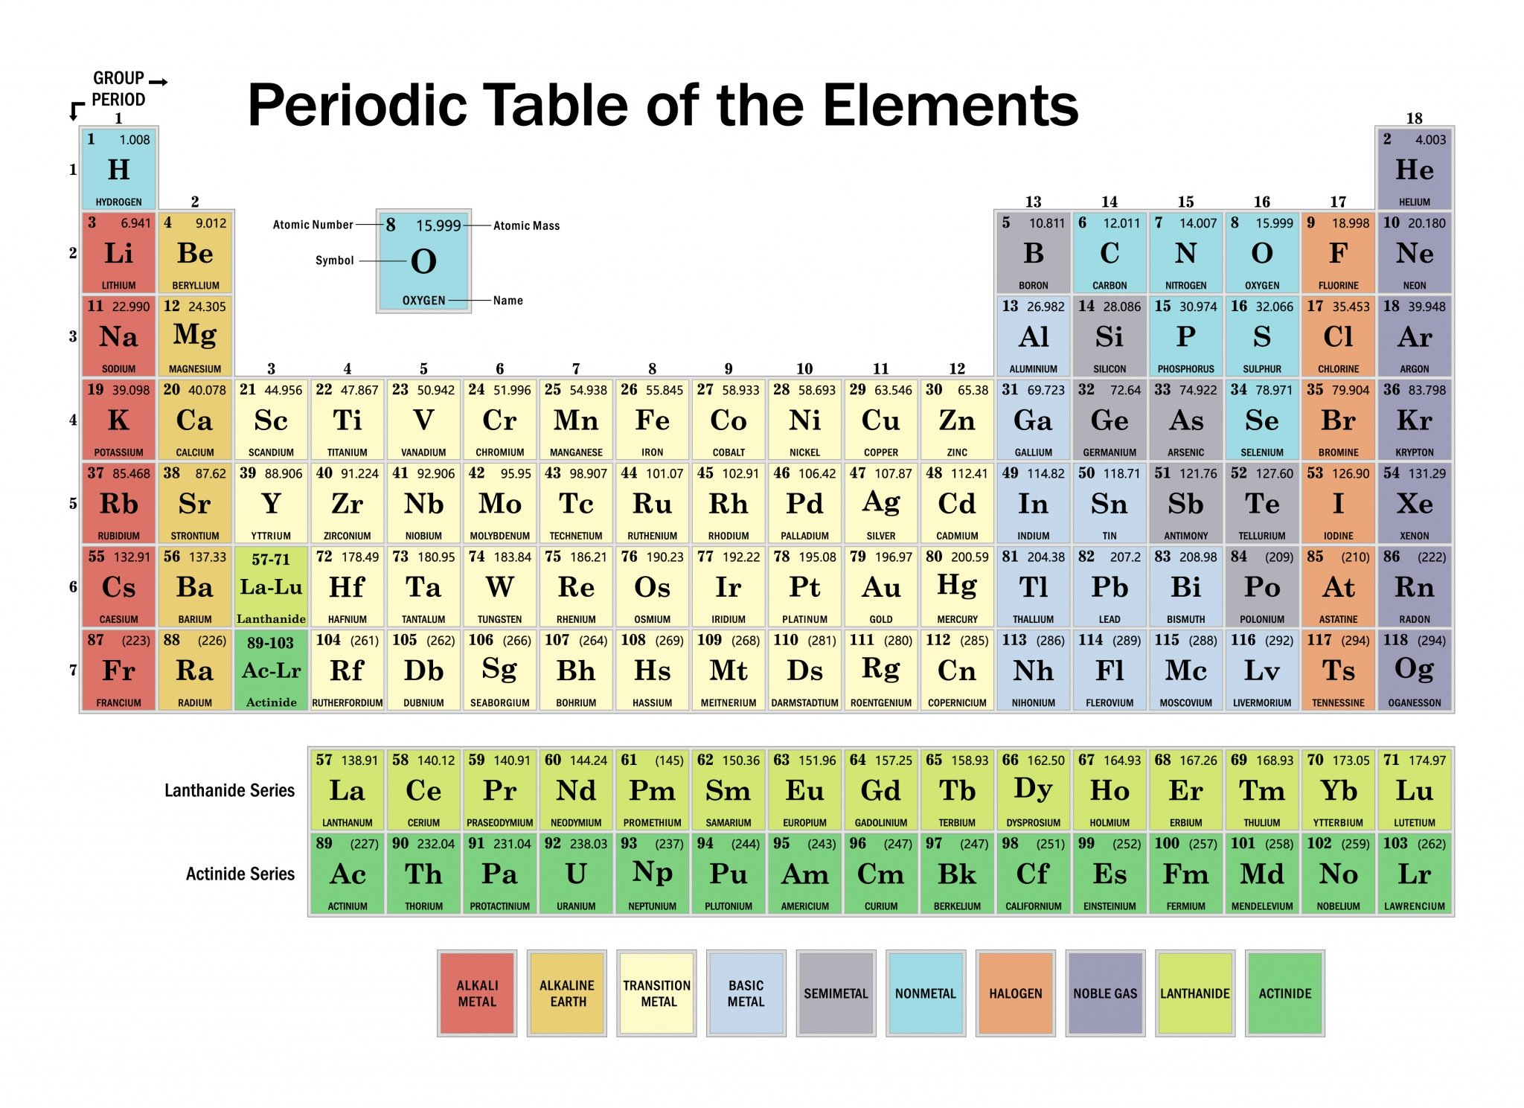
2 Peter 3:10, 12

Slide 3
Basic Elements
OF THE WORLD
OF CHRIST
“basic principles” of the world” Colossians 2:8
“elementary principles of Christ” (Heb. 6:1)
We must ground ourselves in the elements of truth to follow Jesus, Col. 2:5-7

Slide 4
Basic Elements of the World
Not according to Christ
Colossians 2:8
Galatians 4:3

Slide 5
Basic Elements of the World
Rudimentary elements include:
Unbelief, Ephesians 4:17-19
Traditions, commands, and doctrines of men, Colossians 2:8, 20-23
Carnality, 1 John 2:15-17; Gal. 5:19-21
Will (lusts) of men, 1 Peter 4:2-3

Slide 6
Basic Elements of the World
Enslave people in the guilt and death of sin
Romans 3:9-19
Romans 6:16-18, 21, 23

Slide 7
Basic Elements of christ Hebrews 5:12-6:1
First Principles
-Milk
-Unskilled
-Babe -Foundational

Slide 8
Basic Elements of christ Hebrews 5:12-6:1
Starting point for your faith, not the end (5:12)
Foundation for growth (6:1)
Put away principles of the world (sin) to grow, 6:1; 1 Pet. 2:1-2; James 1:21-25

Slide 9
Basic Elements of christ Hebrews 5:12-6:1
Help us become skilled in using more of God’s word (5:13-14)
Learning and using, 5:14; 2 Pet. 3:18
Add to your faith, 2 Peter 1:5-7

Slide 10
Basic Elements of christ Hebrews 5:12-6:1
Build on them, do not forget them (6:1)
Leave (advance), 6:3, 4-6, 11-12
Do not tire of, always remember, 2 Peter 1:12-15

Slide 11
Basic Elements of christ Hebrews 5:12-6:1
Build on them, do not forget them (6:1)
Spiritual growth is being trained to follow and be like Christ, Luke 6:40

Slide 12
Basic Elements
OF THE WORLD
OF CHRIST
Destroy lives and lead to eternal destruction
(Repent)
Lay a foundation of faith on which to build and mature (Phil. 3:14)

