Slide 1
Doctrine of Baptisms
Scripture Reading: Matthew 28:16-20

Slide 2
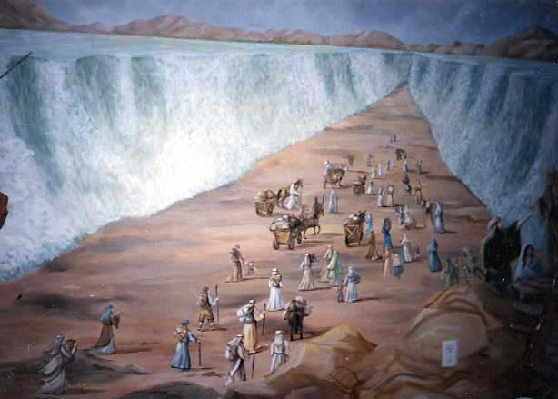
Israel into Moses in the Cloud and Sea 1 Cor. 10:1-2; Psa. 105:39; Exod. 14:19-22
Relationship formed
Follow His authority
Separation from bondage
2

Slide 3
Great Commission Baptism Matt. 28:19; Gal. 3:26-27; Rom. 6:3-4
Relationship formed with Christ
Based on Christ’s authority
Separation from bondage of sin
Learn from Israel, 1 Corinthians 10:5, 6, 11

Slide 4
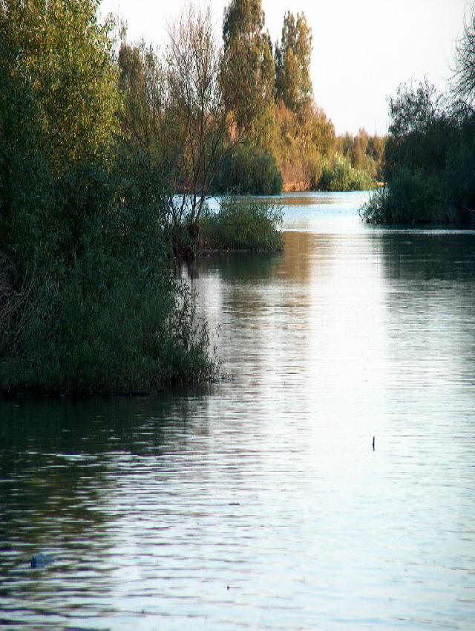
Baptism of John Mark 1:4-8
Baptism of repentance, Mark 1:4-5
Preparatory, Luke 3:3-6; Acts 19:4 (Luke 1:17); Acts 18:25-26
Not final, Acts 19:3, 5
4

Slide 5
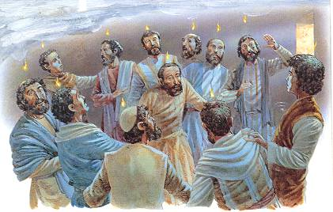
Promised to apostles, John 14:16-18; 15:26-27; 16:7-8, 13; Acts 1:4-5; 2:1-4
Not an ongoing event, Acts 11:15
Not baptism “in the name of Christ,” Acts 2:38 (8:12-17; 10:47-48)
Holy Spirit Baptism (Mark 1:8)
5

Slide 6
Baptism with Fire Matthew 3:11
Judgment / punishment, Matthew 5:22; Mark 9:43-44
Not part of Holy Spirit baptism, Acts 2:3
Fruitless trees and chaff, Matthew 3:10, 12; 25:41; Revelation 20:14-15; 21:8
6

Slide 7
Baptism of Suffering (Mark 10:35-40)
Christ’s suffering
Apostles, 1 Cor. 4:9-13 | Christians, 1 Pet. 3:14
7

Slide 8
Baptism for the Dead 1 Corinthians 15:29
On account of the dead (ones), 15:13, 15-16, 18-20
Affirms resurrection, not proxy baptism, 15:29-34
8

Slide 9
Great Commission Baptism Ephesians 4:5
Prospects, Mark 16:15-16; Acts 2:21, 37-39, 47
Prerequisites Hear, Believe, Confess, Repent, Acts 8:36-37
9

Slide 10
Great Commission Baptism Ephesians 4:5
Results, Acts 2:38; Rom. 6:3-4; 1 Pet. 3:21; 1 Cor. 12:13
-Remission, relationship, salvation, added to church
10

Slide 11
“One Baptism”
Ephesians 4:5; Acts 22:16; Hebrews 5:9
11

